Slide 1


MINA: A Hardware-Efficient and Flexible Mini-InceptionNet Accelerator for ECG Classification in Wearable Devices
Authors
Hoai Luan Pham, Member, IEEE,
Thi Diem Tran, Member, IEEE,
Vu Trung Duong Le, Member, IEEE, and
Yasuhiko Nakashima Senior Member, IEEE
Publication year: MAY 2024
Presenter: Hoang Duy Huong
Presentation date: 17/09/2025

Slide 2
Motivation & Problem Statement
Background & Motivation
ECG (Electrocardiogram) monitoring is critical for heart disease detection.
Wearables require: accuracy, low latency, low energy, compact design.
Limitations of Existing Approaches
Traditional ML (SVM, KNN, HMM): manual feature extraction, less robust under noisy or imbalanced data.
Deep learning (LSTM, Transformers, 2D CNN):
LSTM/Transformers → complex hardware, energy-hungry.
2D CNNs → spectrogram/scalogram conversion, heavy.
Existing 1D CNNs: lighter but still parameter-heavy, memory bottlenecks.
2

Slide 3
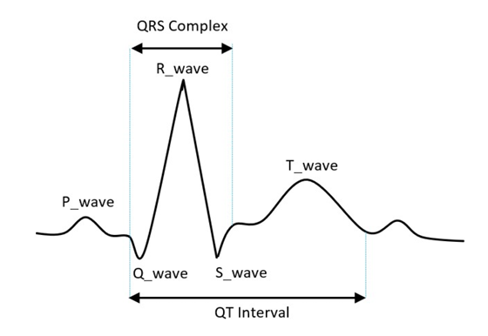
Motivation & Problem Statement
Specific problem the paper addresses
Reduces parameters while maintaining high accuracy.
Improves hardware efficiency (speed, area, power) for wearable deployment.
3

Slide 4
Research Objectives
Main Goals
Develop a compact yet accurate 1D CNN for ECG.
Build a fast, energy-efficient accelerator with small area.
High-level idea of the proposed solution
A Mini-InceptionNet model that reduces parameters while keeping high accuracy.
Key contributions
SW: Multi-kernel (1,3,5,7) convolutions + residual connections. Bottleneck 1×1 to cut parameters.
HW: Flexible PEA (Processing Element Array),
SBA (Sharing Buffer Allocator) to avoid stalls,PE with 4 LDMs supports residual & multi-branch ops.
3-stage pipeline: Load → Allocate → Compute/Store.
4

Slide 5
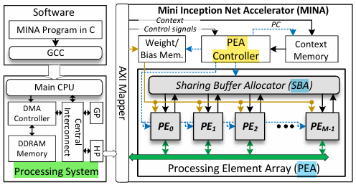
System Model / Architecture Overview
Diagram of the proposed system
5

Slide 6
System Model / Architecture Overview
Key components and their roles
Processing System (PS): runs the MINA program in C, controls data transfer via DMA/AXI, provides configuration contexts.
PEA Controller: manages operations of the Processing Element Array.
Sharing Buffer Allocator (SBA): dynamically distributes pixel data to PEs, preventing memory bottlenecks.
Processing Element Array (PEA): contains multiple PEs working in parallel.
Processing Elements (PEs): each with ALU and local memories, execute convolution, pooling, addition, activation.
5

Slide 7
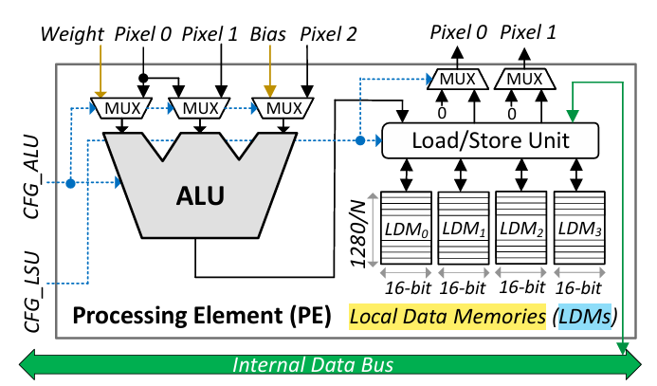
System Model / Architecture Overview
Overview architecture of the processing element (PE)
5

Slide 8
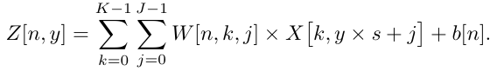
Methodology / Algorithm
Summary of the core method or algorithm
Core idea: use Mini-InceptionNet (1-D CNN) with parallel convolutions (kernels 1, 3, 5, 7) + residual connections → reduces parameters while keeping high accuracy.
Key mathematical models
Z[n,y] : the 1-D convolution output
X[k,y×s+j]: the pixel input
s is the stride
b[n]: the bias
-> Defines how each PE computes convolution in parallel
6

Slide 9
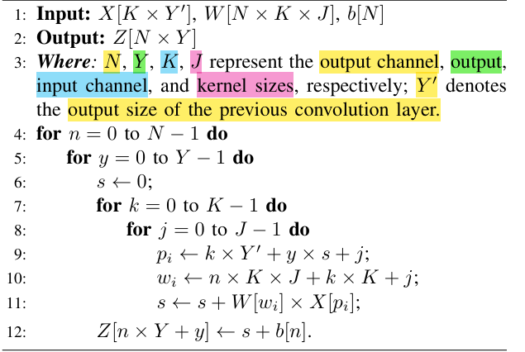
Methodology / Algorithm
Algorithm 1: General 1-D Convolution
6

Slide 10
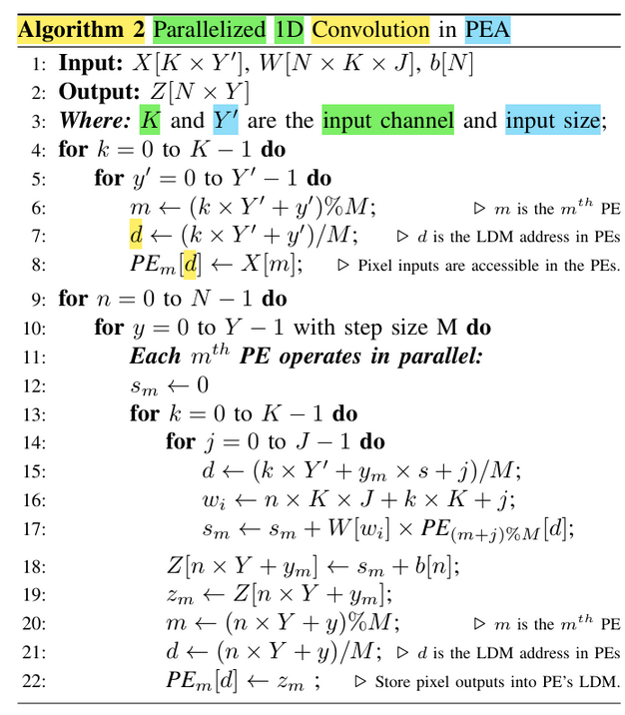
Methodology / Algorithm
6

Slide 11
Implementation & Experimental Setup
Hardware/software platform, simulation tools, datasets used
Hardware:Xilinx Zynq UltraScale+ MPSoC ZCU102 FPGA (with ARM Cortex-A53 CPU).
Software: GCC for C code on ARM CPU, Vivado for FPGA synthesis.
Dataset: MIT-BIH Arrhythmia Database
MINA accelerator implemented in Verilog RTL.
Test scenarios and parameters
Targeted beat classes: Normal (NOR), Left/Right Bundle Branch Block (LBBB, RBBB), Premature Ventricular Contraction (PVC), Atrial Premature Beat (APB).
Training setup: ECG segment = 159 samples before + 160 samples after R-peak. Data split = 70% train, 15% validation, 15% test.
7

Slide 12
Implementation & Experimental Setup
Evaluation criteria
Accuracy (ACC), Sensitivity (SEN), Specificity (SPEC), Positive Predictive Value (PPV) for classification quality.
Inference time (IT) and Area-Delay Product (ADP = IT × Area) for hardware efficiency.
Energy efficiency (EE, GOP/s/MeLUT) to compare against state-of-the-art accelerators.
7

Slide 13
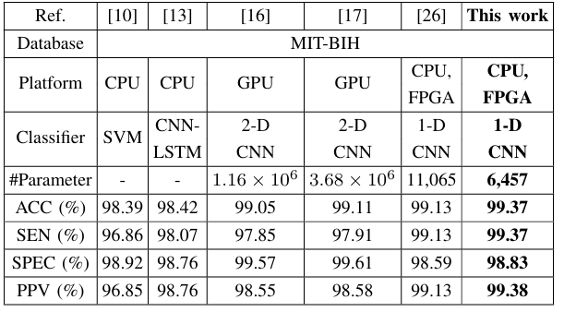
Results & Analysis
Performance results (accuracy, energy, latency, etc.)
COMPARISON OF ECG CLASSIFICATION PERFORMANCE ON MIT-BIH DATASET WITH STATE-OF-ART WORKS
approximately 1.71× smaller than parameters in the best existing model
8

Slide 14
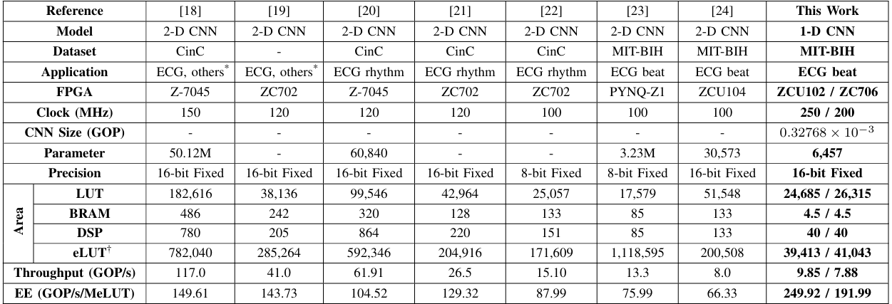
Results & Analysis
Performance results (accuracy, energy, latency, etc.)
COMPARISON WITH FPGA-BASED 2-D CNN HARDWARE ARCHITECTURES FOR ECG CLASSIFICATION
inference times of 34.45 / 43.06 µs, while its energy efficiency (EE) reaches 249.92 / 191.99 GOP/s/MeLUT, offering up to 3.77× and 2.89× improvements over previous designs.
8

Slide 15
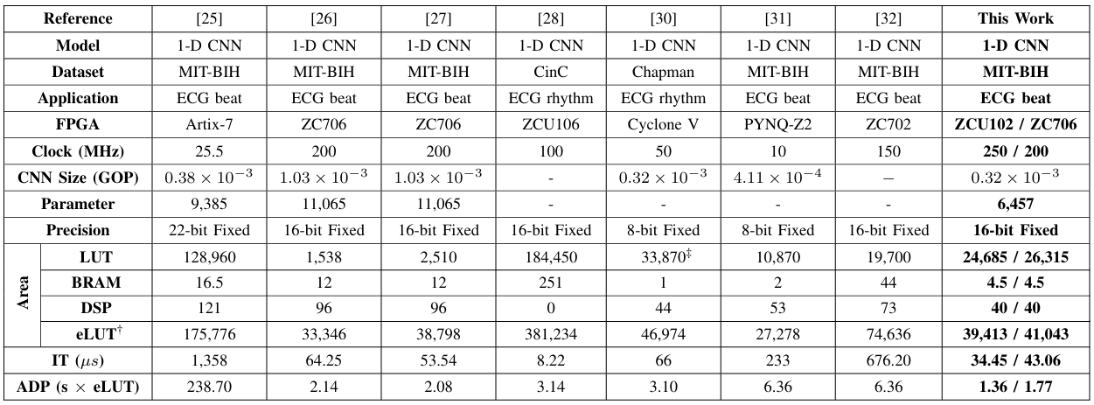
Results & Analysis
Performance results (accuracy, energy, latency, etc.)
COMPARISON WITH FPGA-BASED 1-D CNN HARDWARE ARCHITECTURES FOR ECG CLASSIFICATION.
6,457 parameters, which is 1.71× smaller than [26]
1.55× faster than [26] (IT = 53.54 µs)
39.4× faster than [25] (IT = 1,358 µs),
8

Slide 16
Strengths and Limitations
Technical and practical strengths
High accuracy with compact model: Mini-InceptionNet achieves 99.37% ACC with ~41.6% fewer parameters than prior 1D CNNs.
Hardware efficiency: Flexible PEA + SBA + 4-LDM PEs give fast inference (34–43 µs), small ADP, and high energy efficiency (up to 249.9 GOP/s/MeLUT).
Wearable readiness: Low area and energy cost make the accelerator practical for remote healthcare devices.
Identified limitations or assumptions
Dataset scope: Evaluation mainly on MIT-BIH; generalization to other ECG datasets or noisy real-world signals is not fully tested.
FPGA platform: Results are FPGA-based; ASIC implementation or ultra-low-power chips still need further exploration.
9

Slide 17
Strengths and Limitations
Any improvements suggested by the authors
Apply weight pruning more aggressively to further reduce IT and ADP (~3× speed-up, ~2.13× ADP reduction at 70% pruning).
9

Slide 18
Conclusion & Future Work
Summary of the paper’s contributions
Mini-InceptionNet model: compact 1D CNN with ~41.6% fewer parameters than prior 1D CNNs, while achieving 99.37% accuracy on MIT-BIH.
MINA accelerator: hardware-efficient design with flexible PEA, SBA, and 4-LDM PEs → high throughput, small area, low power.
Empirical validation: FPGA implementation (ZCU102/ZC706) shows inference time of 34–43 µs, energy efficiency up to 249.9 GOP/s/MeLUT, achieving 1.5×–3.7× improvements over state-of-the-art CNN accelerators.
10

Slide 19
Conclusion & Future Work
Potential applications
Wearable ECG monitors for continuous heart-health tracking.
Remote healthcare systems requiring low-power, real-time ECG classification.
Embedded medical devices where accuracy and energy efficiency are both critical.
Future research directions
Integrating pruning/compression techniques more systematically to further reduce latency and ADP.
Extending validation to other ECG datasets and noisy real-world signals.
ASIC implementation for even lower power and higher integration in commercial wearables.
10

Slide 20
Thank you for
your listening!
13

